Slide 1
SSIS package Analyzer Accelerator : A Comprehensive Analysis Solution
April 2025
Confidential
04-02-2024
Tiger Analytics

Slide 2
Unlocking ETL Metadata - Metadata Extraction
The SSIS Package Analyzer is a powerful utility that performs comprehensive metadata extraction from SSIS packages without requiring direct access to the client environment. It systematically scans and catalogs every task, activity, connection, variable, and configuration within the packages, providing detailed insights into data flows, transformations, and dependencies. This tool serves as an essential data discovery mechanism when clients have security restrictions or are unable to provide direct access to their environments.
For organizations facing limited visibility into legacy systems, the analyzer delivers significant value by creating a complete inventory of ETL processes and highlighting complex transformation logic. It empowers migration teams to accurately assess scope, complexity, and effort requirements without administrative access to source systems. This capability not only accelerates the planning phase but also ensures that no critical components are overlooked during migration.

Slide 3
















Architecture for SSIS Package Analyzer
SQL SERVER DB/Excel File stores as Output
Analyzes
Process Containers
Package Analysis Results
SSIS package .DTSX files Directory
Processes
For each package
Analyze all package Files
Package Task Details
SSIS Package Analyzer Class
Single Package Analysis
Extracts
Extracts Metadata
Stores Overview
Package Connection Details
Includes Counts of
Package Container Details
Tasks
Connection Details
Process SQL Queries
Containers
Project Files .dtproj files Directory
SSIS Project Analyzer
Stores
Project Connection Details
Input Source
Package Analysis
Target Database/Excel
SSIS Package Analyzer

Slide 4
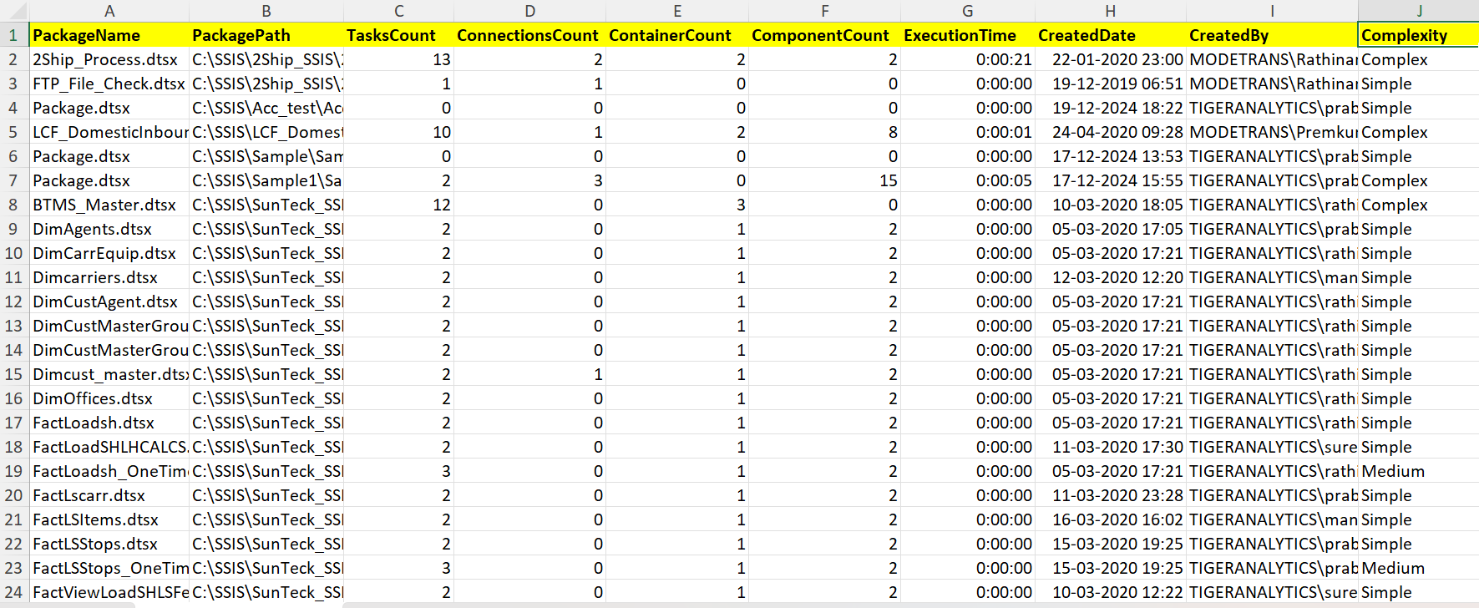
Result Output Screenshots (1/3)
SSIS Package Analysis Results (Inventory)

Slide 5
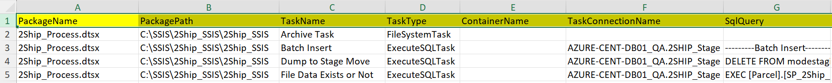
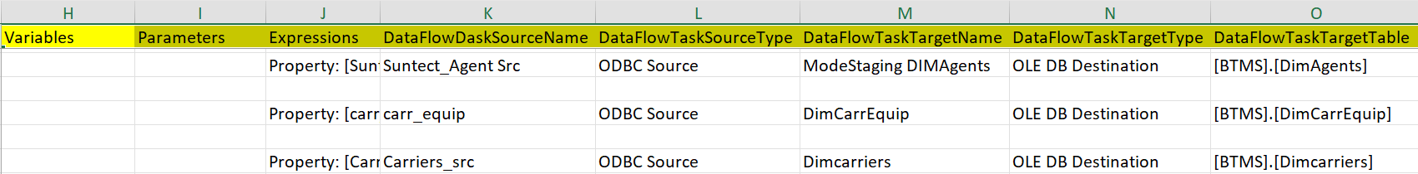
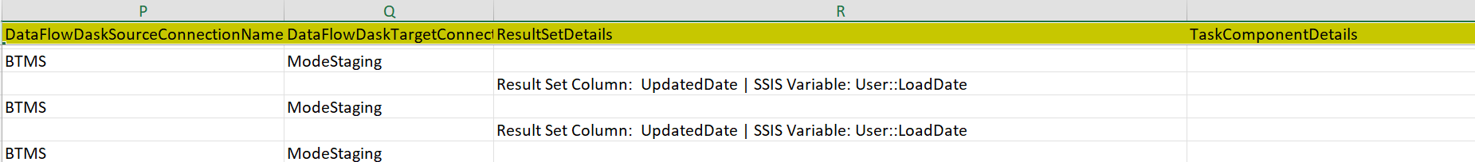
Result Output Screenshots (2/3)
SSIS package details as an output

Slide 6
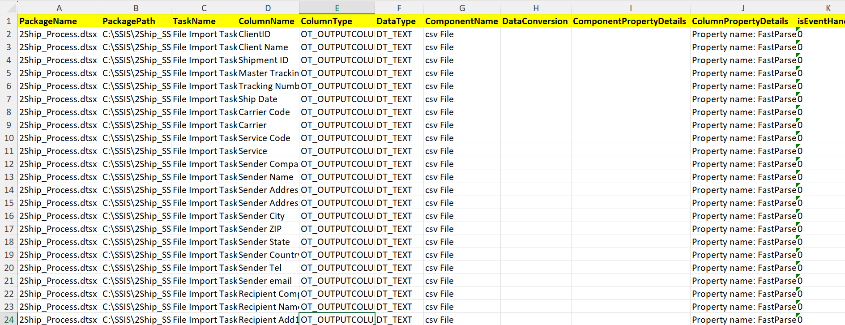
Result Output Screenshots (3/3)
SSIS Package Data Flow mapping details as separate output

Slide 7

Thank You
Uniting Expertise to Achieve Remarkable Outcomes

